Slide 1
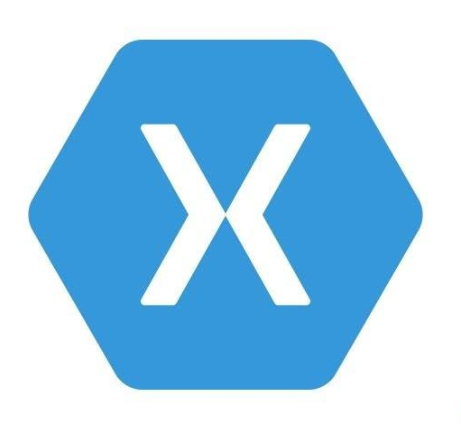


Cross-Platform App Development with Xamarin and Visual Studio App Center
Final Presentation: Peiren Yang

Slide 2
Project Target
Build an infrastructure for app development which supports:
Cross-platform app, one set of code generates at least 3 different applications for Android, iOS and Windows.
Source Control, which allows version control and teamwork
Automatic Builds
Automatic Tests
Release and Deployment management in relation to different App Stores

Slide 3
Solution Approach
Build an infrastructure for app development which supports:
Cross-platform app, one set of code generates at least 3 different applications for Android, iOS and Windows.
Source Control, which allows version control and teamwork
Automatic Builds
Automatic Tests
Release and Deployment management in relation to different App Stores

Slide 4
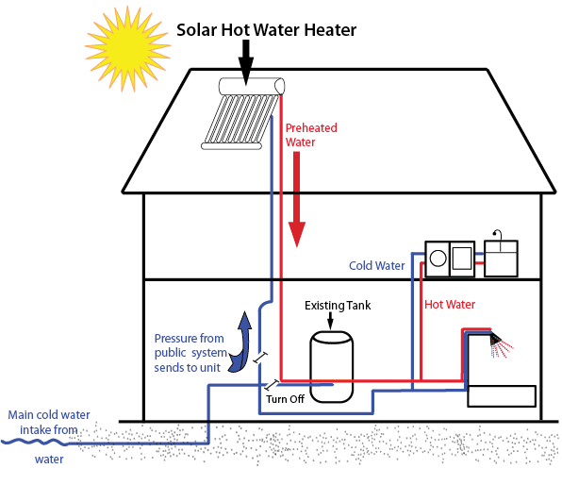
Solar thermal heating system
Solar energy is renewable energy
System efficiency highly related to the weather conditions
Additional heating system is needed to complete the solution
Water Tank
Picture source: www.solar-energy-for-homes.com/build-solar-water-heater.html

Slide 5
Gas heating system with integrated solar Panels
PEIREN YANG

Slide 6
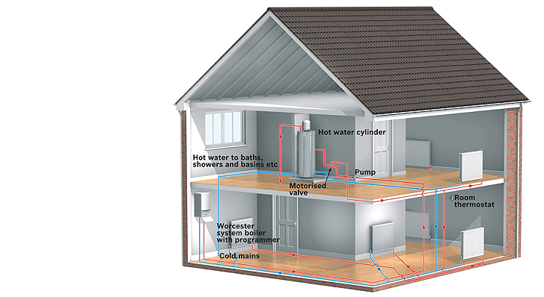
Heating system with natural gas
Water boiler controlled by thermostats
Hot water storage
Insulated water tank
Hot water supplies for
Heating circulation
Bath & shower
Drinking
Picture source: www.gas24.co.uk

Slide 7
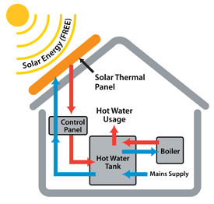
Heating solution with integrated solar system
Heated water is stored in
the same water tank
Gas heating works stable in
cloudy weather and night
Additional control logic for the
synergy of the two systems
Picture source: genesisenergysolutions.com

Slide 8
Evaluation of the solution
Energy efficiency: 94% of industrial average
Installation cost: about 9,000 €
Running cost: about 844 € per year
CO2 Emission: about 8.6 tons per year
Prerequisites
Central control system with thermostat
Natural gas accessibility

Slide 9
PELLET heating system with integrated solar heating system
TIM EISELE

Slide 10
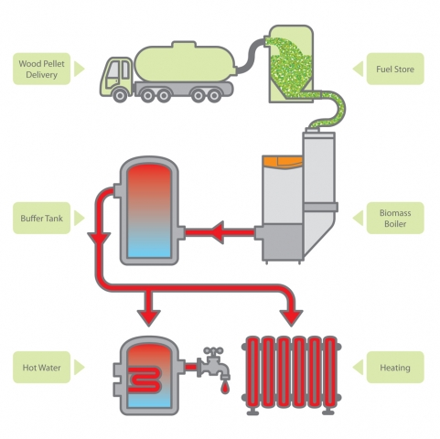
Pellet Heat – Pellet boiler
Water heated inside the boiler
Hot Water stored in tank
Not made for instant hot water delivery

Slide 11
Pellet heat in combination with solar heat
Solar heating system adds 60°C water to the tank
Pellet heating system is on standby as long as tank temperature is sufficient
Instant hot water delivery is available until the capacity of the solar heating system is exhausted

Slide 12
Pellet Heat – Solution Evaluation
Efficiency: 85%
Installation Costs: about 20,000€
Operational Costs: 1,173€ per year
CO₂ Emissions: none, wood is considered CO₂ neutral
Prerequisites: none

Slide 13
Geothermal heating system with integrated solar heating system
JAN DYCKE

Slide 14

Geothermal Heat – Downhole Heat Exchanger
Heat pump collects thermal Energy from the ground
Heats up warm water storage
The higher temperature difference, the lower heat pump efficiency
House
Tank
Heat Pump
Ground (10° -15° C)

Slide 15
Geothermal Heat – Combination with Solar Heat
Solar Heat
Solar system can heat warm drinking water (60°C) more efficiently
Geothermal system has no lead time
Solar overcapacities in summer can be used to regenerate the ground
House
Tank
Heat Pump
Ground (10° -15° C)

Slide 16
Geothermal Heat – Solution Evaluation
Efficiency: up to SPF of 6
Installation Costs: about 20,000€
Operational Costs: about 950€ per year
CO₂ Emissions: none (eco tariff)
Prerequisites: suitable geological realities

Slide 17

Evaluation and Recommendation
Criteria \ Solution | Gas Heating | Pellets Heating | Geothermal Heating
Efficiency | 0 | 0 | +++
Costs | ++ | + - | - 0
CO₂ Emissions | - | 0 | +
Prerequisites | + | 0 | -
 | 3 x + 1 x - | 1 x + 1 x - | 4 x + 2 x -
In urban areas gas heating is the best solution
In suburban and rural areas geothermal heating is the best solution

Slide 18
Q & A

